Slide 1

ECEN 3593-001 Computer Organization
Lecture #27
24 March 2021

Slide 2


Agenda
Class Announcements
Course Project
Chapter 1

Slide 3
Class Announcements
Reading Assignment
“Computer Organization and Design, The Hardware / Software Interface, RISC-V edition,” by David Patterson and John Hennessy
ISBN 978-0-12-812275-4
Chapter 1, “Computer Abstractions and Technology”
Sections 1.1 thru 1.11 required
Section 1.12 (optional)
pages 2-54
OH today 2:00 to 3:00 by request before 2:00 https://cuboulder.zoom.us/j/4317981384

Slide 4
Class Announcements
Phases 5 and 6 are in the deduction period – 1%/day
Phase 7 is in the deduction period, but due to Pause Week the deduction will be 4% through Friday at 10:00 PM. 4%/day after that.
Phase 8 is posted
Target Date Sunday, April 4 at 10:00 PM
Bonus 1%/day (maximum 7%), deduction 4%/day
Homework #4 is posted – Due Date Thursday, April 1 at 10:00 PM

Slide 5
MidTerm Resubmission
To earn back credit on Questions 1 through 10, you must hand in updated solutions showing your work
You will earn 50% of your lost credit back
Due by 10:00 on Wednesday, March 24 (TODAY!)
Handwritten, send photo or scan via Slack DM

Slide 6
Class Project – Phase 7
The HLSW9 error very likely indicates that you have assigned a signal in multiple places – see Section 6.1 of the Phase 5 document
Make sure you have not used “=“ when you want “==“
If your code jumps to an unexpected place, it is likely that the target address r_me_bradd is incorrect
You can only have 11 ALU enums!!
Assign s_ex_zero outside the ALU function

Slide 7
Phase 7
DEBUG, DEBUG, DEBUG
Use the - -info debug function
See the “Debugging Codasip with - -info” document
Don’t stare at your code!

Slide 8
Homework #4 (Very important slide!)
Important: The homework is auto graded, so the answer format recommendations must be followed!
Answer should be P1, P2, or P3
P1
The answer format should be X.XX x 10^y
1.00 x 10^7
Answer is in rounded Integer Seconds
25 seconds
25 S
Answer format is X.XX CPI
1.76 CPI
If you do not follow the prescribed format, you may not receive credit for the answer or you may receive only partial credit. READ INSTRUCTIONS!
Everyone has a powerful tool to make this easy - Excel

Slide 9
Calculating effective CPI based on weighted averages
Mult 2 cycles
Add 1 cycle
Addi 1 cycle
Bne 1 cycle
What is the effective CPI?
Weighted averages:
Mult = 2/4 = .5
Add = 1/4 = .25
Addi = 1/4 = .25
Bne = 1/4 = .25
Total = 1.25
Processor A’s assembly code looks like:
Move $s0, $zero
Move $s1, Increase_Thrust_To
Move $s2, Thrust
Move $s3, Thrust_Increment
Bqe $s0, $s1, At_Thrust
Loop Mult $t0, $s0, $s3
Add $s2, $s2, $t0
Addi $s0, 1
Bne $s0, $s1, Loop
At_Thrust

Slide 10
Calculating effective CPI based on weighed averages
Alternative compiled code sequences using instructions in classes A, B, C
Class | A | B | C
CPI for class | 1 | 2 | 3
IC with compiler 1 | 2 | 1 | 2
IC with compiler 2 | 4 | 1 | 1
Sequence 1: IC = 5
Clock Cycles = 2×1 + 1×2 + 2×3 = 10
Avg. CPI = 10/5 = 2.0
Sequence 2: IC = 6 (Poll)
Clock Cycles = 4×1 + 1×2 + 1×3 = 9
Avg. CPI = 9/6 = 1.5

Slide 11
Calculating CPU Time
Calculate the CPU time for the following program:
Processor clock rate = 2 GHz
FP inst: 50x10^6 with CPI = 6
INT inst: 150x10^6 with CPI = 1
L/S inst: 30x10^6 with CPI = 4
Branches: 20x10^6 with CPI = 2
300x10^6
150x10^6
120x10^6
40x10^6
Clock Period -> 500x10^-9 times
610x10^6 =
305x10^0 seconds

Slide 12
Calculating CPU Time
Calculate the CPU time for the following program:
Processor clock rate = 2 GHz
FP inst: 50x10^6 with CPI = 6
INT inst: 150x10^6 with CPI = 1
L/S inst: 30x10^6 with CPI = 4
Branches: 20x10^6 with CPI = 2
3
X
150x10^6
150x10^6
120x10^6
40x10^6
Clock Period -> 500x10^-9 times
460x10^6 =
230x10^0 seconds

Slide 13
What is the Performance Improvement?
Slow FP – 1/305 = 3.28 x 10^-3
Fast FP – 1/230 = 4.35 x 10^-3
Fast FP is 4.35/3.28 = 1.33 times faster
Even though the FP performance was doubled
Amdahl’s Law

Slide 14
Proposed - Computers at low utilization use little power
Power utilization does matter at low workloads
Google’s warehouse scale computers normally run from 10% to 50%
Run at 100% less than 1%

Slide 15
Computers at low utilization use little power
Power utilization does matter at low workloads
Google’s warehouse scale computers normally run from 10% to 50%
Run at 100% less than 1%
Cause of disproportional energy savings is due to leakage current of very small semiconductor geometries used in today’s CPU server chips
Leakage current of the latest Intel processor can be 40% of the total power
At a system level, similar effects of Amdahl’s Law
Reducing CPU usage does not always result in proportionally reduced system level components’ power
Computers at low utilization use little power is a fallacy

Slide 16
Proposed - Designing for performance and designing for energy efficiency are unrelated

Slide 17
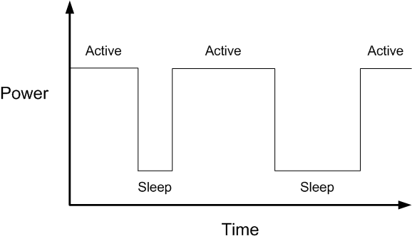
Common Power Analysis Case
In many applications, processors move between different states (e.g. Active and Sleep)

Slide 18
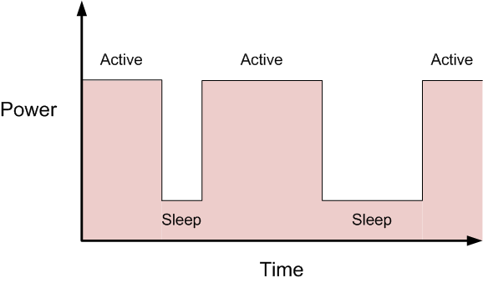
Common Power Analysis Case
Energy is the integral under the power curve

Slide 19
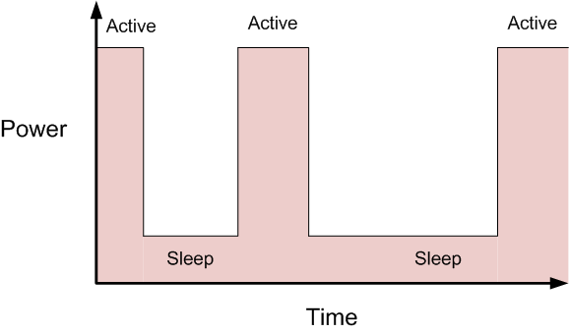
Common Power Analysis Case
A processor which uses more Power but is faster may consume less Energy

Slide 20
Designing for performance and designing for energy efficiency are unrelated
Example:
Processor 1 requires 80mS to complete its work every 1 second
Average current for 1 second is:
(3.6mA * .080) + (0.001mA * (1-0.080))
0.288mA + 0.00092mA
~0.29mA (equivalent to 0.29mJ since the average is over 1 second)
Processor 2 requires 100mS to complete its work every 1 second
Average current for 1 second is:
(3.0mA * .100) + (0.001mA * (1-0.100))
0.300mA + .0009mA
~0.30mA (equivalent to 0.30mJ since the average is over 1 second)
Designing for performance and designing for energy efficiency are unrelated is a fallacy
The higher performing processor with
higher power
can be more energy efficient

Slide 21
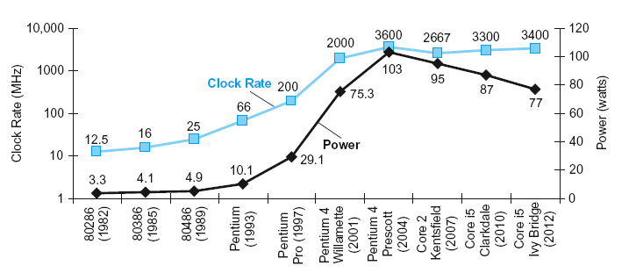
Designing for Power
In CMOS IC technology
×30
5V → 1V
×1000

Slide 22
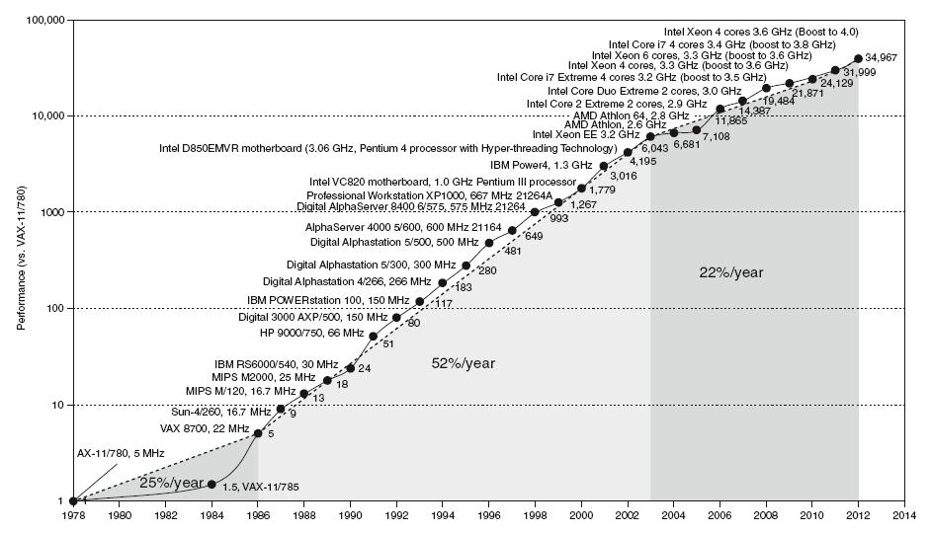
Uniprocessor Performance
Constrained by power, instruction-level parallelism, memory latency

Slide 23
Current Performance Drivers
Multicore microprocessors
More than one processor per chip
Requires explicitly parallel programming
Compare with instruction level parallelism
Hardware executes multiple instructions at once
Example - pipelining
Hidden from the programmer
Hard to do
Programming for performance
Load balancing
Optimizing communication and synchronization

Slide 24
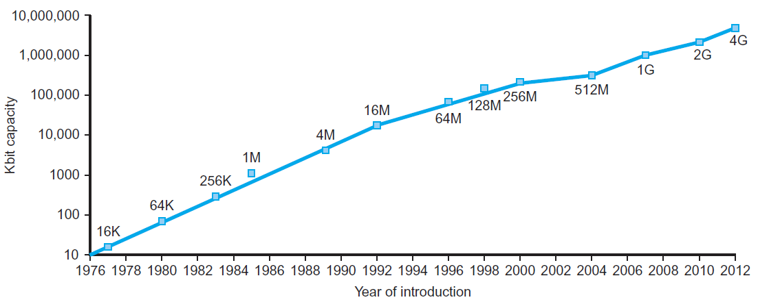
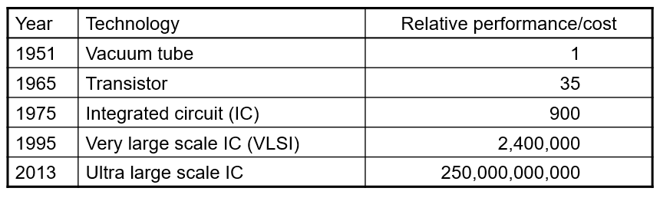
Technology Trends
Electronics technology continues to evolve
Increased capacity and performance
Reduced cost

Slide 25
Semiconductor Technology
Silicon: semiconductor
Add materials to transform properties:
Conductors
Insulators
Switch

Slide 26
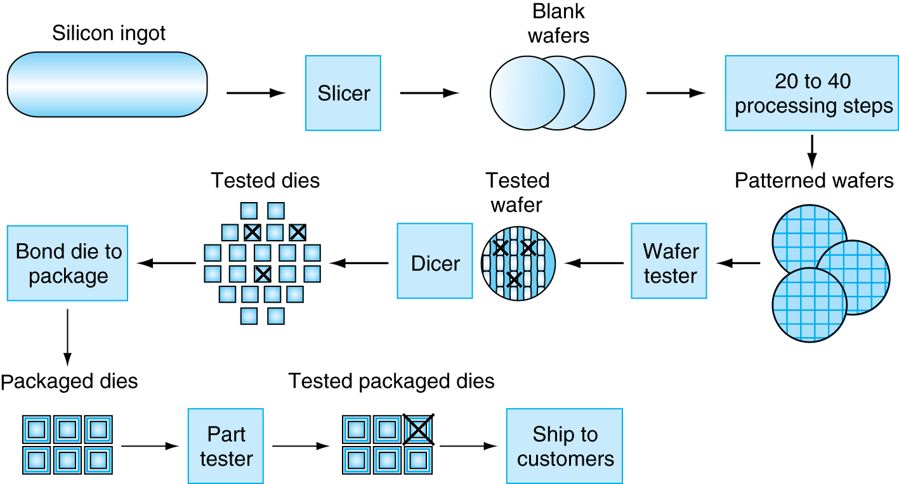
Manufacturing ICs
Yield: proportion of working dies per wafer

Slide 27
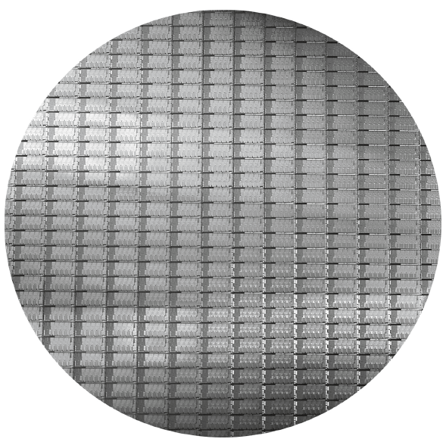
Intel Core I7 Wafer
300mm wafer, 280 chips, 32nm technology
Each chip is 20.7 x 10.5 mm

